Slide 1
Assertiveness
Training for being assertive

Slide 2




Styles of Communication
Passive
Passive/Aggressive
Aggressive
Assertive
Notes:
I am not okay, you are okay
I am not okay, you are not okay
I am okay, you are not okay
I am okay, you are okay

Slide 3
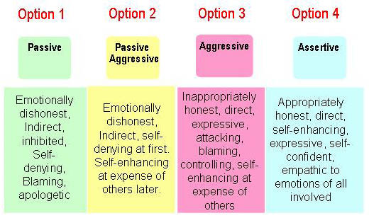

Slide 4

Passive Communication
I am not okay, You are okay
Soft voice
Overly agreeable, no point of view expressed
Avoidance
Withdrawn body language
Sound unsure
Sound hopeless or helpless
Notes:
Low volume, hard to hear. Agrees with you to keep everything nice. Thinks the way to deal with a concern is to avoid dealing with it. No direct eye contact. Does not present a confident posture. Uses language such as “ perhaps, maybe, or hopefully”. “I don’t know if this idea will help.” They never state the point clearly and directly. You may hear a lot of I cant's and I don’t knows such that no plan of action or possible solution is introduced. “I tried that once, but it didn’t work, so what can you do?”

Slide 5

Some Passive Messages
“Uh…if that’s the way you want to do it…um, that’s fine with me.”
“I don’t know if I could do that.”
“I’ll talk to him soon about that problem; I’ve just been really busy.”
“I’m sorry to ask you.”
“I hate to bother you.”
“Maybe that’s a good idea.”

Slide 6

Passive/Aggressive
I am not okay, You are not okay
Appears to agree but really does not agree
Tells others but not the source of the concern
Makes subtle digs and sarcastic remarks
Keeps score, sets conditions
Nonverbal message contradicts the
verbal message
Holds back expressing concerns or providing assistance
Notes:
One of the common behaviors of passive-aggressiveness is that the speaker sounds as though he or she is going along with or agreeing to something, but his or her actions that follow don’t show support or commitment. Instead, the passive-aggressive speaker claims that any agreement was actually a misunderstanding, or the speaker carries out actions that are contrary to the supposed commitment. They do not deal directly with concerns about others. Complaining about that person to other people- behind that person’s back- is a common way to handle concerns. Many a truth is said in jest, especially by passive-aggressive communicators. Put-downs are concealed with sarcasm. When the speaker uses no sarcasm, his or her tone may be condescending and hurtful to the person hearing it. Often the passive-aggressive speaker expresses displeasure not through words but through nonverbal means, such as rolling the eyes, shaking the head, or making sighs of disgust. Cooperation comes with limitations or conditions. Memories are long and forgiveness is short. Another tactic of the passive-aggressive is to settle the score by giving you the silent treatment, not showing up when help is needed, sabotaging your efforts behaind the scenes, and sending harsh messages via e-mail. Stated words sound positive, but body language or tone of voice gives the words the opposite meaning. “Everything is fine” means that something is wrong. “Nothing is bothering me” means that something is bothering me. “That’s a good idea” means that it isn’t and so on.Witholds information or other forms of support when others can use it to get a job done. In addition, he or she holds emotions in, although you may get a sense of them in the speaker’s body language or from implied negative messages. Nothing is said directly, and when asked about a concern or issue, the response is usually “Never mind,” or “ No big deal.”
Second-guessing or Armchair quarterbacking. After an event or action has taken place, they respond with what you should’ve done or what you did wrong- sometimes even when you requested input beforehand and he or she gave none. This communication style is very quick to pass judgement.

Slide 7

Some Passive/Aggressive Messages
“I knew that wouldn’t work.”
“If that’s the way you want it…”
“How could you even think that?”
“ When was the last time you helped me?”
“The problem with Joe is…”

Slide 8

Aggressive
I am okay, You are not okay
Blaming, accusing
Intimidating body language
Demanding, ordering
Raised voice
Harsh, personal language
Verbal browbeating
Notes:
Aggressive communicators are quick to find fault and focus on the wrongs that the other person supposedly committed. Pointing fingers, moving closer to you, getting in your face to argue a point, or pounding on a table with his or her fist. They tell you what you MUST do. Voice gets louder and the tone becomes sharper. Aggressive communicators focus on the person more than the issue. The language is often filled with a lot of you insuts and, at times, with profanity. Tact or diplomacy is tossed aside. When you disagree with an aggressive communicator, it often turns into a competition. The way to win is not to listen, to interrupt, talk louder, and verbally attack the other person.

Slide 9

Some Aggressive Messages
“You must…”
“Because I said so.”
“You idiot!”
“You always…”
“You never…”
“Who screwed this up?”

Slide 10

Assertive
I am okay, You are okay
Takes responsibility
Takes initiative
Listens actively
Speaks up, is direct and constructive
Shows sincerity
Is solutions focused
Assumes a confident voice and body language
Addresses concerns directly to the source
Requests needs
Notes:
No excuses, no woe-is-me language, no blaming others for problems. Assertive communicators are responsible for his or her own actions. They accept what has happened and focus on what needs to be done next. If something need to happen, he or she takes the initiative to get the process rolling- no waiting for others what to say what to do and when to act. Assertiveness allows for two-way conversation. Show a willingness to hear the other person out and understand his or her point of view. If a point needs to be made or a thought needs to be expressed, an assertive communicator speaks up. He or she states the point directly without beating around the bush. Assertive speakers use language constructively; that is, they communicate the message in the best way possible and make the point clearly. The language4 focuses on the issue at hand. When you express yourself sincerely, you say what you mean and mean what you say- and do so with respect for others. In problem situations, an assertive person takes a problem-solving approach. He or she examines the problem, not ot blame or find fault with anyone but ot understand the issue and move toward developing a solution. Creating the solution becomes the main focus in working with others. The voice of an assertive speaker sounds strong, certain, and firm when needed.
Posture, gestures, and facial expressions support his or her message. He or she sounds and looks alive when speaking, coming across nonverbally as positive and enthusiastic to an appropriate degree. Assertive people address issues directly to the source as opposed to telling others about the problem. No browbeating or blaming occurs. The assertive person ASKS for or requests what is needed, unlike the Aggressive who demands or orders.

Slide 11
Some Assertive Messages
“Yes, that was my mistake.”
“As I understand your point…”
“Let me explain why I disagree with that point.”
“Let’s define the issue and then explore some options to help resolve it.”
“Please hear me out and then work with me to resolve my concern.”

Slide 12
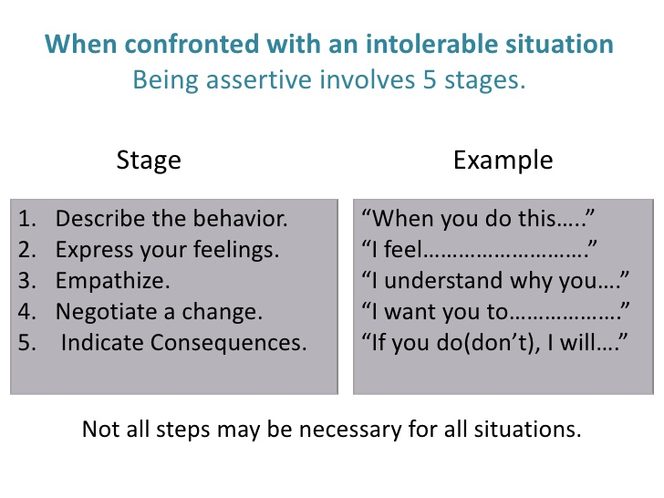

Slide 13
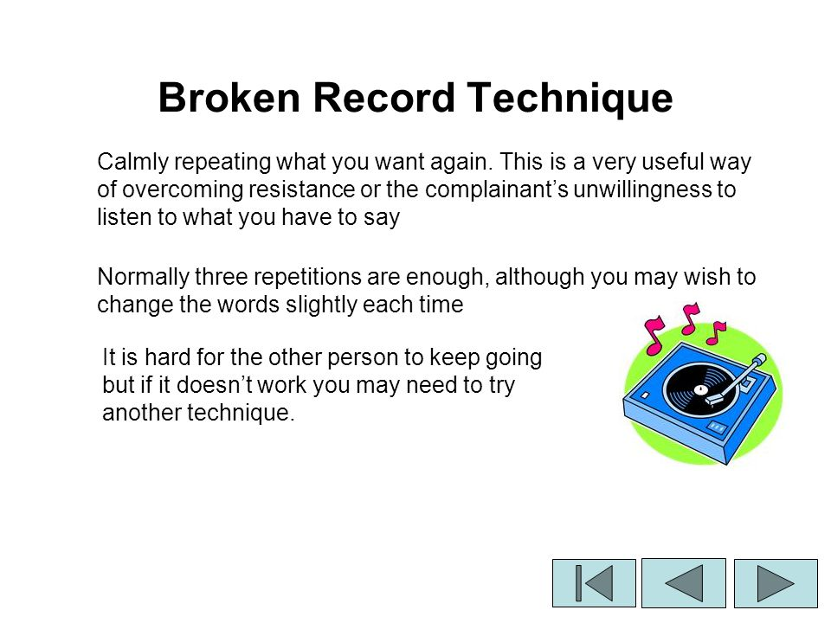

Slide 14
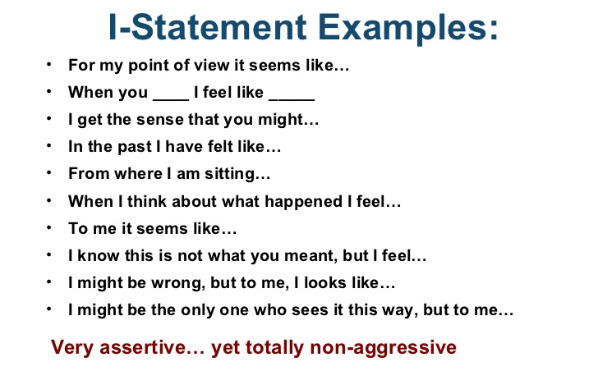

Slide 15
Don’t confuse aggressive with assertive.
Aggressive
Blunt
Harsh in tone
Blame and Browbeat
Push for your own way
One-way conversation flow
Assertive
Direct
Firm in tone
Collaborates on solutions
Speaks up, yet hears others opinions
Two-way conversation flow

Slide 16
It Isn’t Just What You Say, But How You Say It
Nonverbal Assertiveness
Notes:
Assertive speaking is about delivering your message in a positive, direct, and confident manner while maintaining respect for the person or persons to whom you are expressing that message. Nonverbal tools can greatly impact how your message is expressed and received by others. Your words alone-that verbal stuff- aren’t the only component of speaking. In fact what you say is important, but how you say it often carries more weight. Most people haven’t been taught how to truly listen; therefore , you can’t count on them to listen fully and effectively when you speak to them.

Slide 17

Eye Contact
Make steady eye contact
Maintain eye contact
Look in the right places
Notes:
The idea is to look at people when you’re talking to them. Steady does not mean constant staring. Look at your listener’s face, near the eyes. PRACTICE: Ask someone to receive your message and give your message while giving steady eye contact. Now repeat the same message while looking away most of the time. Which message evokes a more favorable response.

Slide 18

Eye Contact Pitfalls
Staring and glaring
Looking away and all around
Darting glances
Blinking excessively
Focusing in on one person
Glazing over
Notes:
Staring and glaring can be interpreted as aggressive. Little of no eye contact causes listeners to drift away. Darting glances create a distraction to the listener and may cause them to lose the focus of your message. Blinking excessively may give the appearance that you lack confidence in your message, and in the blink of an eye the receiver will too. In meetings when your eye contact stays with only one person, the other listeners feel isolated and left out. This can happen when you are overly absorbed in your own thoughts or when you lose your train of thought. Once is no big deal, but have it happen more than that during a conversation and you appear to have tuned out you won message. Don’t expect other to tun in if you’re not doing so yourself.

Slide 19

Body Language
Posture
Facial expressions
Gestures
Notes:
Posture is how you carry and position yourself. Sit up and face your receiver as a means of expressing your message assertively. It is also helpful to lean forward a bit as well. Most important interactions take place while you’re seated. PRACTICE: Sit up right now. What do you notice? You’re more alert. Lean a little forward with it and you have a more commanding presence to go with your message. Although you can’t see your face when talking, unless you are looking in a mirror, you can tell what your face is doing. Your face communicates emotions to others. The idea in expressing yourself assertively is to show positive life through your facial expressions. Smile while you speak and it causes the muscles in your face to change and helps pick up the inflection in your voice. Have your facial expressions match what you say. PRACTICE: Ask someone to receive your message. Make it a short message of two or three sentences and start out by sayin, “ Something important to me is…” First say your message showing a great deal of interest with your facial expression. Now repeat the same message with a blank look void of any expression. Ask you test subject to let you know which message evokes a more favorable response. Gestures are what you do with your hands when you’re talking. Use gestures to come across assertively, to help your message flow properly, and in essence, to punctuate or emphasize key points when you’re talking. You may notice that your gestures have connections to yur facial expressions, helping you deliver your message in an animated way within your own style.

Slide 20

Body Language Pitfalls
Slouching
Invading space
Hovering over the listener
Looking blank
Looking stern
Displaying threatening gestures
Folding your arms
Exhibiting distracting habits

Slide 21
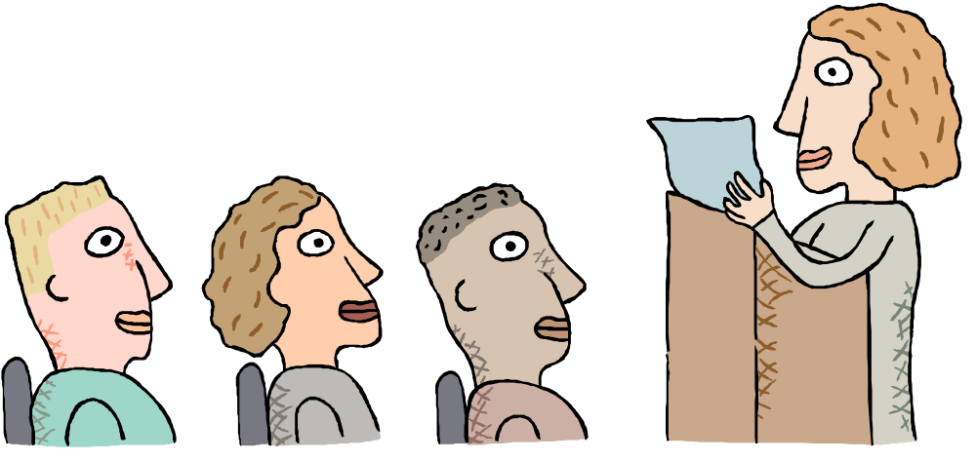
Set the Tone
Project your voice
Show rhythm in your voice
Display sincerity in your tone
Notes:
The idea is to be heard loud and clear. Vary your volume for the situation. Always keep it at a volume that makes your voice easy to be heard. Inflection deals with your pitch. If you’re at a high pitch, your voice comes across as shrill, which nobody wants to hear. If you stay at one pitch, and a rather flat one at that, you sound dull. The key to being assertive is to have variety-known as modulation- in your pitch. In particular, modulation makes your voice pleasant to listen to and conveys energy in your message. A tone of sincerity basically says,” I mean what I say, I say what I mean, and I do so with respect toward you.”

Slide 22

Vocal Pitfalls
Sounding uncertain
Being too soft-spoken
Mumbling
Being to loud
Dropping your voice at the end of a sentence
Sounding Monotonous
Putting people down with your tone
Having harshness in your tone
Speaking too fast
Using excessive filler sounds

Slide 23
Assertive Communication is
Not a guarantee
Not another “should”
Not negative
Taking charge of oneself
Middle ground style
An active expressive focus
Notes:
not a guarantee that assertive people always get what they want. Others have the same rights you have to be assertive. The emphasis is on a maximization strategy.
not another should. It should never become a “have to” but a “be able to” be assertive. Perfect, “by the book”, communication exists only in educational movies.
Beware of the three P’s – Perfection, Procrastination, Paralysis
not negative. Too many confuse assertiveness with aggressiveness. It is important to be able to confront others, to disagree, to say “no”, and to ask for what you want, but if that is all we do, we will distance others we work and interact with. Assertive people can say “yes” and “no”, “I like” and “I don’t like”, “I agree” and “I disagree”. Balance is crucial for effective communication in the business world.
Taking charge of oneself. It has an expressive emphasis—being able to express what one wants, feels, and thinks without abusing others.
Middle groundd style that allows a clear communication without being a steamroller or a doormat.
an active, expressive focus; assertive people stay in the game.

Slide 24
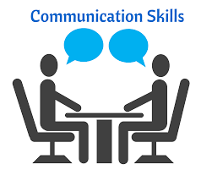


Slide 25
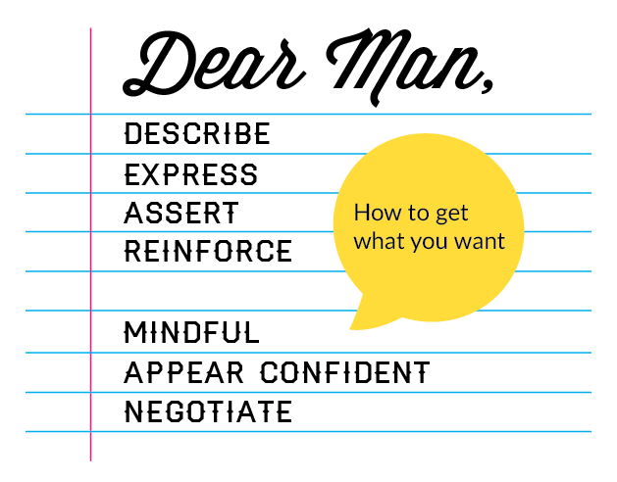

Slide 26
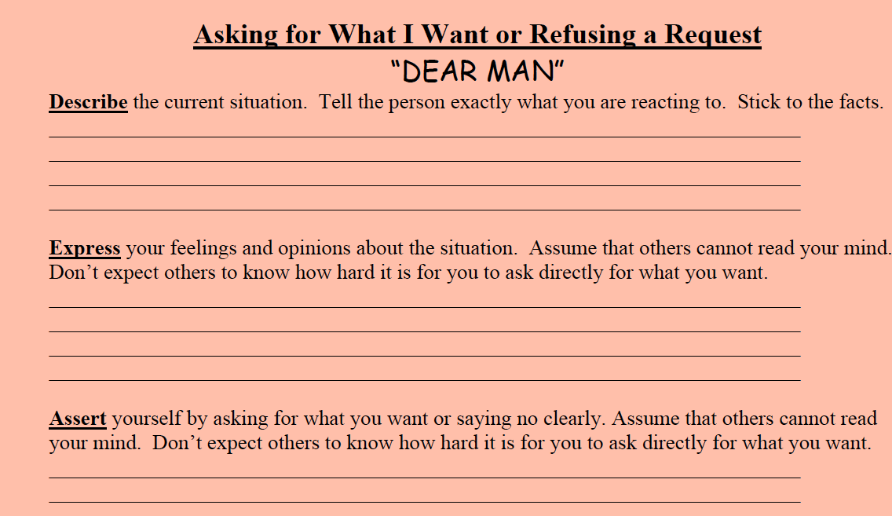

Slide 27
